Slide 2
NODAL ANALYSIS
  Nodal analysis provides a general procedure for analyzing circuits using node voltages as the circuit variables.
  Choosing node voltages instead of element voltages as circuit variables is convenient and reduces the number of equations one must solve simultaneously.
  Nodal analysis is also known as the node-voltage method.
  Given a circuit with n nodes without voltage sources, the nodal analysis of the circuit involves taking the following three steps.

Slide 3
NODAL ANALYSIS
  Steps to Determine Node Voltages
  Select a node as the reference node. Assign voltages V₁, V₂………..V_{n-1} to the remaining n-1 nodes. The voltages are referenced with respect to the reference node.
  2. Apply KCL to each of the n-1 non-reference nodes. Use Ohm’s law to express the branch currents in terms of node voltages.
  3. Solve the resulting simultaneous equations to obtain the unknown node voltages.

Slide 4
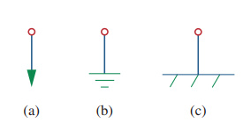
NODAL ANALYSIS
  The reference node is commonly called the ground since it is assumed to have zero potential.
  A reference node is indicated by any of the three below symbols. The type of ground in Fig.(c) is called a chassis ground and is used in devices where the case, enclosure, or chassis acts as a reference point for all circuits

Slide 5
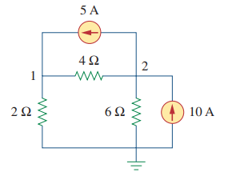
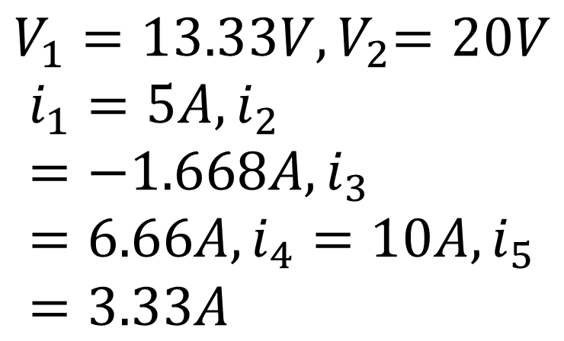
NODAL ANALYSIS
  Example 01: Calculate the node voltages and currents for the given circuit below

Slide 6
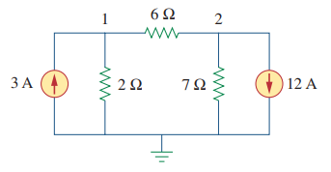

NODAL ANALYSIS
  Class work 01: Calculate the node voltages for the given circuit below

Slide 7
MESH ANALYSIS
  A loop is a closed path with no node passed more than once.
  A mesh is a loop that does not contain any other loop within it.
  Nodal analysis applies KCL to find unknown voltages in a given circuit, while mesh analysis applies KVL to find unknown currents.
  Mesh analysis is not quite as general as nodal analysis because it is only applicable to a circuit that is planar.

Slide 8
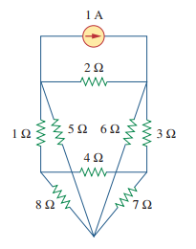
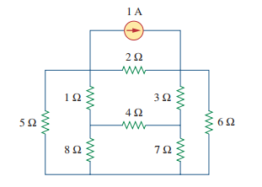
MESH ANALYSIS
  A planar circuit is one that can be drawn in a plane with no branches crossing one another; otherwise it is nonplanar

Slide 9
MESH ANALYSIS
  Steps to Determine Mesh currents
  Assign mesh currents i₁, i₂………..i_{n} to the n meshes.
  Apply KVL to each of the n meshes. Use Ohm’s law to express the voltage in terms of the mesh currents.
  Solve the resulting n simultaneous equations to get the mesh currents

Slide 10
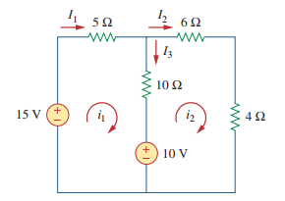
MESH ANALYSIS
  Example 3: Find the branch currents using mesh analysis

Slide 11
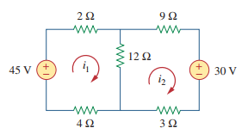

MESH ANALYSIS
  Class works 03: Find the branch currents using mesh analysis

Slide 12
MESH VS NODAL ANALYSIS
  Given a network to be analyzed, how do we know which method is better or more efficient?
  First factor: The nature of the particular network
  Networks that contain many series-connected elements, voltage sources, are more suitable for mesh analysis,
  Whereas networks with parallel-connected elements, current sources, are more suitable for nodal analysis.

Slide 13
MESH VS NODAL ANALYSIS
  Second factor.
  A circuit with fewer nodes than meshes is better analyzed using nodal analysis,
  While a circuit with fewer meshes than nodes is better analyzed using mesh analysis.
  The key is to select the method that results in the smaller number of equations.

Slide 14
MESH VS NODAL ANALYSIS
  Third factor: The information required
  If node voltages are required, it may be expedient to apply nodal analysis.
  If branch or mesh currents are required, it may be better to use mesh analysis

Slide 15
LINEARITY PROPERTY
  Linearity is the property of an element describing a linear relationship between cause and effect.
  The property is a combination of both the homogeneity (scaling) property and the additivity property.
  The homogeneity property requires that if the input (also called the excitation) is multiplied by a constant, then the output (also called the response) is multiplied by the same constant.
  Example Ohm’s law relates the input i and to the output v.

Slide 16
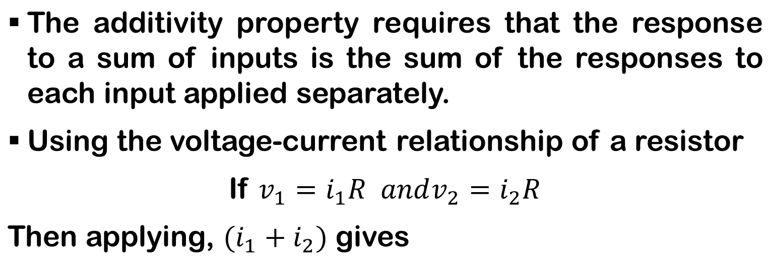

LINEARITY PROPERTY

Slide 17
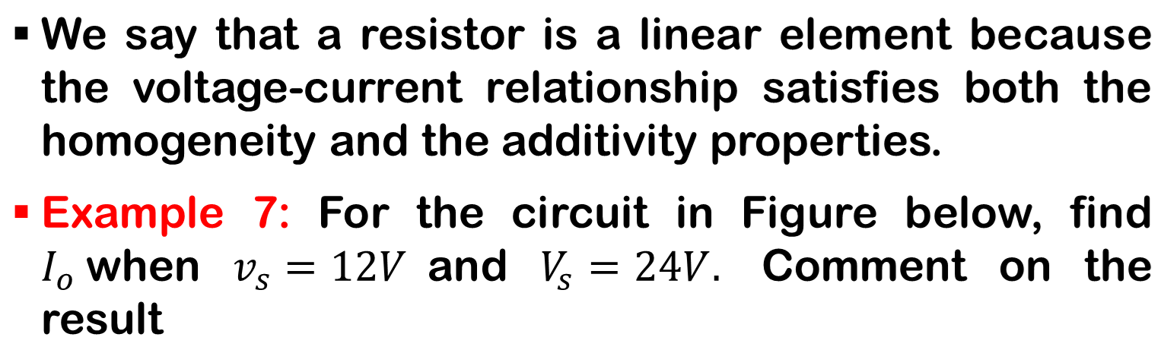
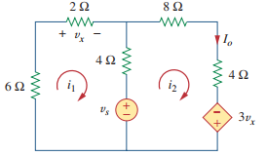
LINEARITY PROPERTY

Slide 18

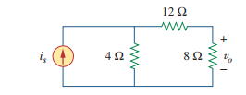

LINEARITY PROPERTY

Slide 19
SUPERPOSITION THEOREM
  If a circuit has two or more independent sources, one way to determine the value of a specific variable (voltage or current) is to use nodal or mesh analysis.
  Another approach is known as the superposition.
  The superposition principle states that the voltage across (or current through) an element in a linear circuit is the algebraic sum of the voltages across (or currents through) that element due to each independent source acting alone.

Slide 20
SUPERPOSITION THEOREM
  Important things to know
  1. We consider one independent source at a time while all other independent sources are turned off. This implies that we replace every voltage source by 0 V (or a short circuit), and every current source by 0 A (or an open circuit).
  2. Dependent sources are left intact because they are controlled by circuit variables.

Slide 21
SUPERPOSITION THEOREM
  We apply the superposition principle in three steps:
  1. Turn off all independent sources except one source. Find the output (voltage or current) due to that active source using the previous techniques covered.
  2. Repeat step 1 for each of the other independent sources.
  3. Find the total contribution by adding algebraically all the contributions due to the independent sources

Slide 22
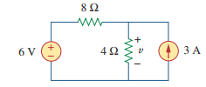

SUPERPOSITION THEOREM
  Example 07: Use the superposition theorem to find v in the circuit of Figure below

Slide 23

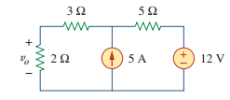
SUPERPOSITION THEOREM

Slide 24
THEVENIN’S THEOREM
  It often occurs in practice that a particular element in a circuit is variable (usually called the load) while other elements are fixed.
  As a typical example, a household outlet terminal may be connected to different appliances constituting a variable load. Each time the variable element is changed, the entire circuit has to be analyzed all over again.
  To avoid this problem, Thevenin’s theorem provides a technique by which the fixed part of the circuit is replaced by an equivalent circuit.

Slide 25
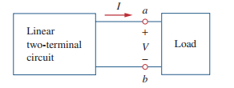
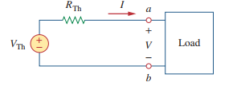
THEVENIN’S THEOREM

Slide 26
THEVENIN’S THEOREM
  Thevenin’s theorem states that a linear two-terminal circuit can be replaced by an equivalent circuit consisting of a voltage source V_{Th} in series with a resistor R_{Th}, where V_{Th} is the open-circuit voltage at the terminals, and RTh is the input or equivalent resistance at the terminals when the independent sources are turned off.

Slide 27
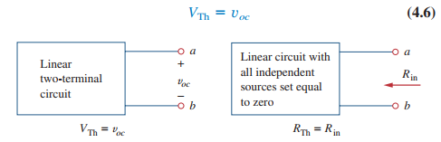
THEVENIN’S THEOREM
  How to find the Thevenin equivalent voltage Vth and resistance Rth?
  To do so, suppose the two circuits in Figure below are equivalent. Two circuits are said to be equivalent if they have the same voltage-current relation at their terminals.

Slide 28
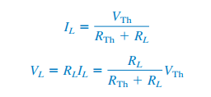
THEVENIN’S THEOREM
  CASE 1 If the network has no dependent sources, we turn off all independent sources. R_{th} is the input resistance of the network looking between terminals a and b.
  CASE 2 If the network has dependent sources, we turn off all independent sources. As with superposition, dependent sources are not to be turned off because they are controlled by circuit variables

Slide 29
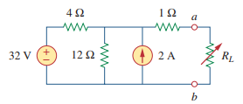
THEVENIN’S THEOREM
  Example 9: Find the Thevenin equivalent circuit of the circuit shown in Figure below , to the left of the terminals Then find the current through R_{L}=2Ω

Slide 30
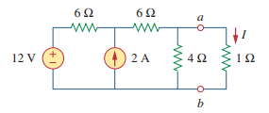
THEVENIN’S THEOREM
  Class work 9: Using Thevenin’s theorem, find the equivalent circuit to the left of the terminals in the given circuit below. Then find I…………….2

Slide 31
NORTON’S THEOREM
  Norton’s theorem states that
  “A linear two-terminal circuit can be replaced by an equivalent circuit consisting of a current source I_{N} in in parallel with a resistor R_{N}, where I_{N} is the short-circuit current through the terminals and R_{N} is the input or equivalent resistance at the terminals when the independent sources are turned off”

Slide 32
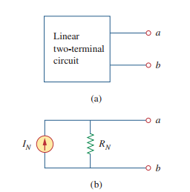
NORTON’S THEOREM

Slide 33

NORTON’S THEOREM
    Required to find Norton current, I_{N,} and Norton resistance, R_{N}
    To find the Norton current we determine the short-circuit current flowing from terminal a to b in both circuits.
    It is evident that the short circuit current is Norton current I_{N.}

Slide 34

NORTON’S THEOREM
    Dependent and independent sources are treated the same way as in Thevenin’s theorem
    Observe the close relationship between Norton’s and Thevenin’s theorems: R_{N} = R_{TH.}

Slide 35
NORTON’S THEOREM
    Since R_{N} and R_{TH} are related according to the above equation, determining the Thevenin or Norton equivalent circuit requires that we find
    1. The open-circuit voltage across terminals a and b.
    2. The short-circuit current at terminals a and b.
    3. The equivalent or input resistance at terminals a and b when all independent sources are turned off.

Slide 36
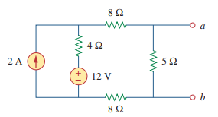


NORTON’S THEOREM
    Example 8: Find the Norton equivalent circuit of the circuit at terminals a-b shown in figure below

Slide 37
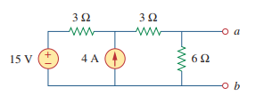
NORTON’S THEOREM
    Class work 8: Find the Norton equivalent circuit of the circuit at terminals a-b shown in figure below

Slide 38
MAXIMUM POWER TRANSFER
    In many practical situations, a circuit is designed to provide power to a load.
    There are applications in areas such as communications where it is desirable to maximize the power delivered to a load.
    The Thevenin equivalent is useful in finding the maximum power a linear circuit can deliver to a load.
    We assume that we can adjust the load resistance If the entire circuit is replaced by its Thevenin equivalent except for the load

Slide 39
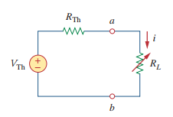

MAXIMUM POWER TRANSFER
    Numerical derivation of the theorem
    Maximum power is transferred to the load when the load resistance equals the Thevenin resistance as seen from the load (RL RTh).

Slide 40

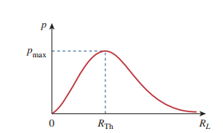
MAXIMUM POWER TRANSFER
    Maximum power transfer takes place when the load resistance equals the Thevenin resistance.
    Power delivered to the load as a function of RL

Slide 41
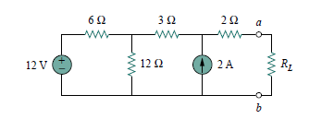
MAXIMUM POWER TRANSFER
    Example 10
Find the value of Load resistance for maximum power transfer in the circuit of Fig. below Then obtain the maximum power. And sketch the P-R cave

